Slide 1

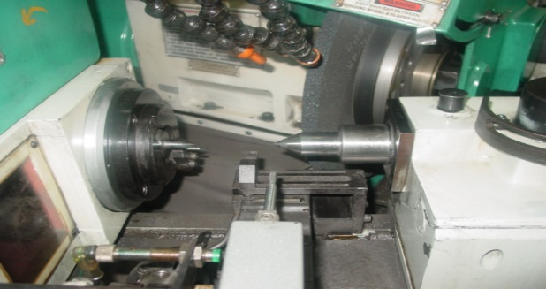
P15
TPM CIRCLE NO :-
ACTIVITY
KK
QM
PM
JH
SHE
OT
DM
E&T
KAIZEN IDEA SHEET
TPM CIRCLE NAME :
LOSS NO. / STEP
DEPT :- Machine Shop
RESULT AREA
P
Q
A
C
D
S
M
CELL :- Grinding.
CELL NAME:- GRINDING CELL
MACHINE / STAGE :- Finish Grinding
OPERATION :- Grinding
KAIZEN THEME : To Reduce Wheel Dressing time Occurances & Increase Wheel Life Occurrence.
IDEA :- Provided 60mm thickness wheel & Correct Machine angle 0 degree.
COUNTERMEASURE:- Angular Grinding Head Angle Changed to 00 Provided.
BENCHMARK
1 No.
WIDELY/DEEPLY:-
TARGET
0 No.
KAIZEN START
10.06.2016
PROBLEM / PRESENT STATUS :- Dressing time Occurrence after every 10nos .
NA.
KAIZEN FINISH
15.06.2016
TEAM MEMBERS :-
Sandip Jagtap,Sandip D,
Sachin.C,Sandeep P.
BENEFITS :-
1. Increase Dressing Frequency up to 50 nos. .
2. Wheel life increase up to 9000nos .
KAIZEN SUSTENANCE
BEFORE : Machine with Angular Grinding Head
AFTER : Machine with Straight Grinding Head
WHY - WHY ANALYSIS :-
Why1: Dressing time Occurrence after every 10nos.
Why 2 :- Charter mark on job.
Why 3:- Wheel Vibration during Grinding.
Why 4:- Less Contact area
Why 5:- Wheel Thickness 20mm with angular head (45 Degree ).
RESULT :-
WHAT TO DO: NA.
HOW TO DO: NA.
FREQUENCY : NA.
Result monitoring
COST INCURRED FOR MAKING KAIZEN
MATERIAL COST
IN RS
LABOUR COST
IN RS
TOTAL COST
IN RS
ROOT CAUSE :- :- Wheel Thickness 20mm with angular head (450 ).
.
------------
-------
---------
REGISTRATION NO. & DATE: 10.06.16
SCOPE & PLAN FOR HORIZONTAL DEPLOYMENT
REGISTERED BY :- Sandip Jagtap
SR.
NO.
CELL
TARGET
RESPONSIBILITY
STATUS
---
----
-------
------
------
MANAGER’S SIGN :- D.Y.Pawer.

